Slide 1


Sina Bolouri
18th Feb 2025
https://github.com/cnabolouri/cnabolouri.github.io.git

Slide 2
Outline
Executive Summary
Introduction
Methodology
Results
Conclusion
Appendix
https://github.com/cnabolouri/cnabolouri.github.io.git

Slide 3
Summary of Methodologies
- Data Collection & Processing
Extracted SpaceX launch data from online sources.
Cleaned missing values and standardized data formats.
Applied one-hot encoding for categorical variables.
- Exploratory Data Analysis (EDA)
Analyzed trends in launch sites, payload masses, and success rates.
Visualized distributions using scatter plots, bar charts, and pie charts.
Mapped launch sites and their proximities to coastlines and infrastructures.
- Feature Engineering
Created dummy variables for categorical columns.
Normalized numerical variables (e.g., Payload Mass).
Executive Summary
https://github.com/cnabolouri/cnabolouri.github.io.git

Slide 4
Executive Summary
- Machine Learning Model Training
Used Logistic Regression, SVM, Decision Trees, and KNN for classification.
Applied GridSearchCV to optimize hyperparameters.
Evaluated models using accuracy, confusion matrix, and best hyperparameters.
- Geospatial Analysis
Mapped launch sites using Folium.
Plotted distances between launch sites and key landmarks (cities, railways, highways).
Analyzed launch site success rates using marker clusters.

Slide 5
Summary of All Results
- Launch Success Rates
Overall success rate: ~83% across all launch sites.
Highest success rate observed at KSC LC-39A launch site.
- Payload vs. Success
Higher payload masses had a higher success rate.
Geosynchronous (GTO) orbits showed lower success rates than Low Earth Orbits (LEO).
Executive
Summary
https://github.com/cnabolouri/cnabolouri.github.io.git

Slide 6
- Best Machine Learning Model
Support Vector Machines (SVM) with RBF Kernel provided the highest validation accuracy (~83%).
Logistic Regression, Decision Tree, and KNN had similar accuracy.
- Launch Site Proximities
All launch sites are near coastlines for safety reasons.
Most launch sites are far from major cities but close to infrastructure like railways and highways.
Executive
Summary
https://github.com/cnabolouri/cnabolouri.github.io.git

Slide 7
Project Background and Context
Space exploration has significantly advanced in recent years.
Private companies, particularly SpaceX, are at the forefront of innovations in reusable rocket technology.
The Falcon 9 rocket, developed by SpaceX, has:
- Drastically lowered the cost of space travel.
- Allowed for the reuse of first-stage boosters.
A thorough understanding of the factors that influence successful rocket landings is essential for:
- Enhancing efficiency.
- Lowering costs.
- Ensuring the reliability of missions.
Introduction
https://github.com/cnabolouri/cnabolouri.github.io.git

Slide 8
Introduction
This project aims to:
- Analyze historical SpaceX launch data.
- Identify the key factors affecting mission success.
The methodologies employed include:
- Data analytics.
- Machine learning.
- Geospatial visualization.
The analysis will focus on:
- Launch patterns.
- The impact of payloads.
- The influence of infrastructure on launch success.
https://github.com/cnabolouri/cnabolouri.github.io.git

Slide 9
Problems We Want to Find Answers To
- What factors influence the success or failure of Falcon 9 launches?
Examining the role of payload mass, orbit type, and booster version on landing success.
Analyzing how launch sites impact mission outcomes.
- Which launch sites have the highest success rates?
Identifying the best-performing launch sites for booster landings.
Evaluating the proximity of launch sites to coastlines, cities, and infrastructure.
Introduction
https://github.com/cnabolouri/cnabolouri.github.io.git

Slide 10
- Can we predict launch success using machine learning?
Training classification models (Logistic Regression, SVM, Decision Trees, KNN) to predict successful launches.
Comparing model performance and selecting the most accurate predictor.
- What insights can geospatial analysis provide?
Mapping launch site locations and their distances to nearby cities, highways, and coastlines.
Exploring patterns in launch site selection and infrastructure accessibility.
Introduction
https://github.com/cnabolouri/cnabolouri.github.io.git

Slide 11

Section 1
https://github.com/cnabolouri/cnabolouri.github.io.git

Slide 12
Methodology
Methodology
This project follows a structured data-driven approach to analyze SpaceX launch success factors. The methodology consists of the following key steps:
1. Data Collection Methodology
Data was sourced from publicly available SpaceX launch records, including historical mission data, payload specifications, and launch outcomes.
Web scraping techniques were employed to extract relevant data from Wikipedia and SpaceX API.
The dataset was stored in CSV format and loaded into Pandas for further analysis.
2. Data Wrangling
The dataset underwent preprocessing to handle missing values and ensure consistency.
Data was filtered and cleaned to retain only relevant Falcon 9 launches.
Columns with missing values, such as Payload Mass and Landing Pad, were either imputed with mean values or retained as missing indicators.
https://github.com/cnabolouri/cnabolouri.github.io.git

Slide 13
3. Exploratory Data Analysis (EDA)
SQL queries were used to extract insights on launch frequencies, payload distributions, and landing success rates.
Visualizations using Matplotlib and Seaborn helped identify patterns in launch outcomes based on payload, launch sites, and orbit types.
4. Interactive Visual Analytics
Folium was used to create an interactive map of SpaceX launch sites, highlighting their proximity to coastlines, highways, and urban areas.
Plotly Dash was implemented to build a dynamic dashboard for real-time exploration of mission success rates and launch trends.
5. Predictive Analysis Using Classification Models
Machine learning models (Logistic Regression, SVM, Decision Tree, and KNN) were trained to predict launch success.
GridSearchCV was used for hyperparameter tuning to optimize model performance.
Model evaluation was conducted using accuracy scores, confusion matrices, and validation datasets.
https://github.com/cnabolouri/cnabolouri.github.io.git

Slide 14
The data collection process for this project involved extracting, filtering, and structuring SpaceX launch data from various sources. The key steps are outlined below:
1. Data Sources
Wikipedia Web Scraping: Used BeautifulSoup to extract launch records such as flight numbers, dates, payload mass, orbit types, and mission outcomes.
SpaceX API: Retrieved real-time launch data, including landing outcomes and booster versions.
CSV Files: Preprocessed datasets from IBM Skills Network were used to ensure structured and clean data for analysis.
Data Collection
https://github.com/cnabolouri/cnabolouri.github.io.git

Slide 15
2. Data Extraction & Processing
Extracted relevant columns from web-scraped tables and formatted raw JSON data from the API.
Used Pandas to clean missing values and standardize data types.
Removed Falcon 1 launches to focus only on Falcon 9 missions.
3. Data Storage & Retrieval
Data was stored in CSV files for structured processing.
SQL database (SQLite) was used for query-based data retrieval.
Interactive visual analytics tools such as Folium and Plotly Dash used this structured data for real-time insights.
Data Collection
https://github.com/cnabolouri/cnabolouri.github.io.git

Slide 16
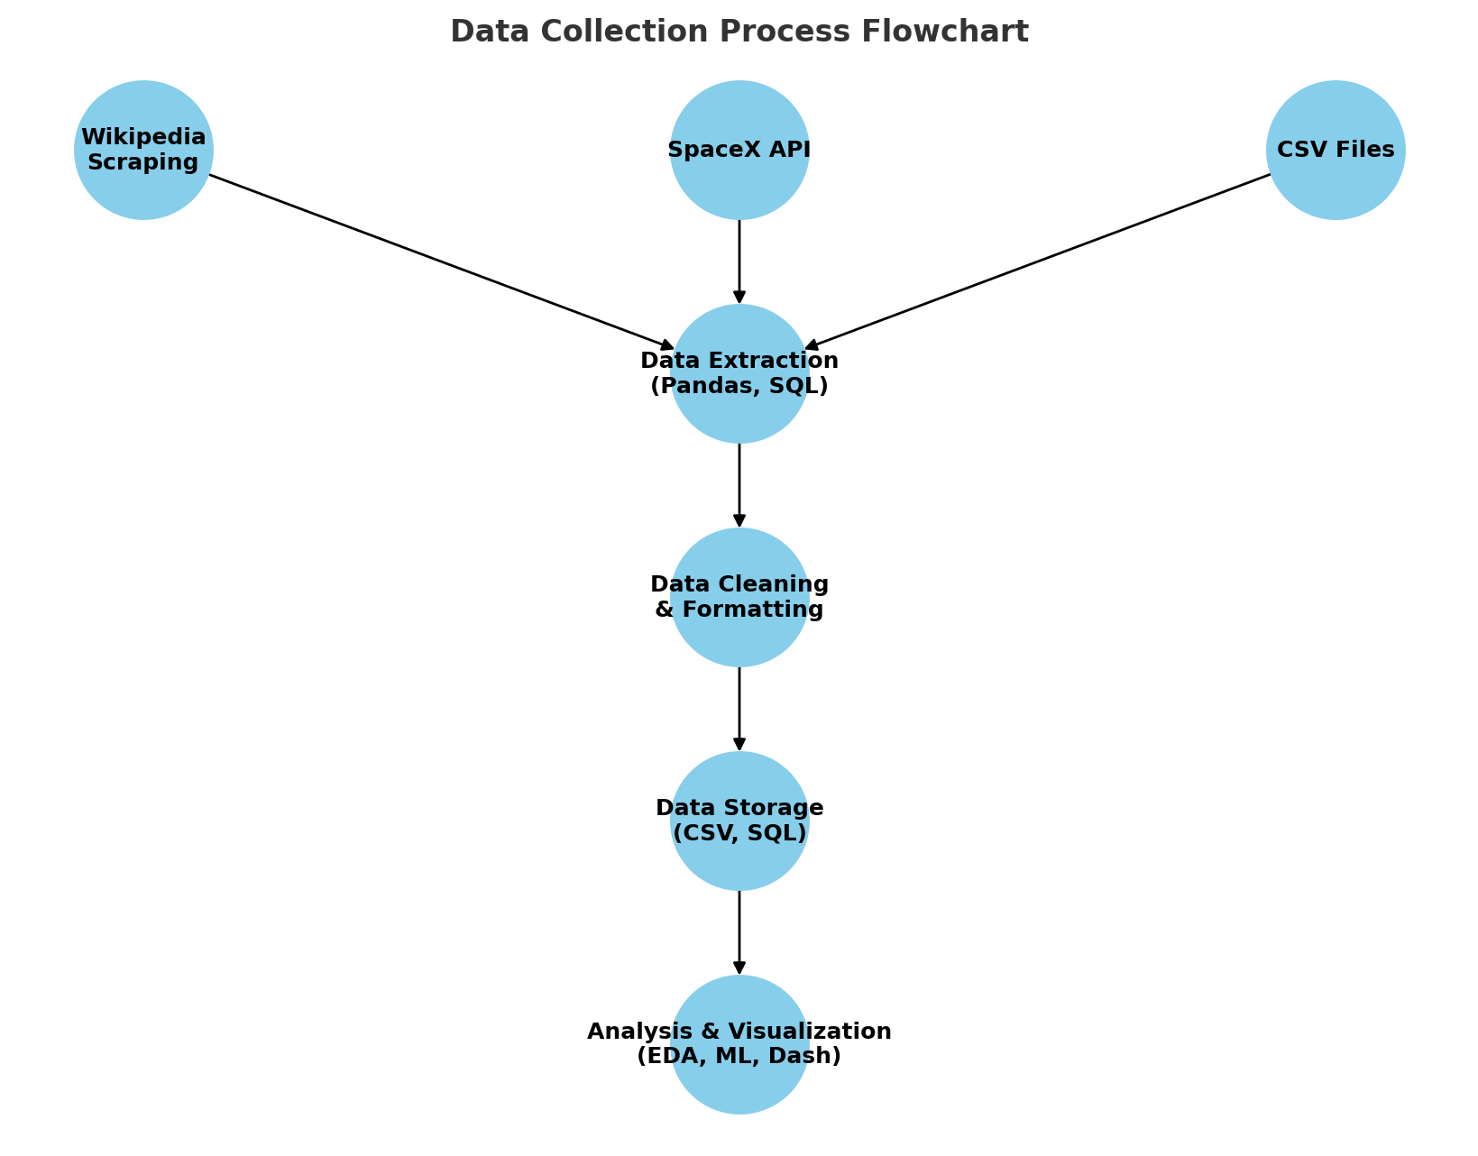
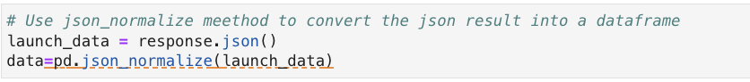
Data Collection – SpaceX API
https://github.com/cnabolouri/cnabolouri.github.io.git

Slide 17
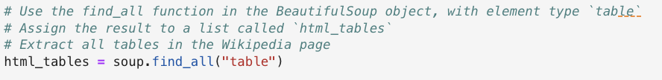
Data Collection - Scraping
https://github.com/cnabolouri/cnabolouri.github.io.git

Slide 18
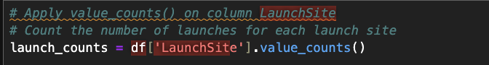
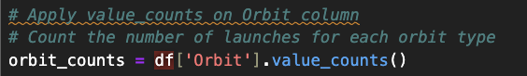
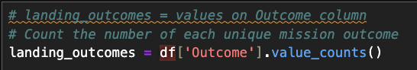
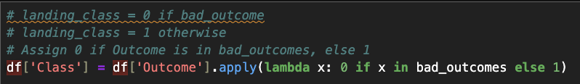
- Data analysis and exploration. - Establishing training labels.
Data Wrangling
https://github.com/cnabolouri/cnabolouri.github.io.git

Slide 19
Bar Chart: Launch Success Rate by Site
This chart was used to compare the number of successful and failed launches across different launch sites.
It helped identify which launch sites had the highest success rates.
Pie Chart: Proportion of Successful Launches
Displayed the overall success rate of SpaceX launches, showing the proportion of successful vs. failed launches.
Provided a quick understanding of SpaceX’s performance in landing rocket boosters.
Scatter Plot: Payload Mass vs. Success Rate
Plotted payload mass against mission success to examine whether heavier payloads affected launch outcomes.
Different colors were used to distinguish successful and unsuccessful launches.
Scatter Plot: Flight Number vs. Launch Site
Used to analyze how experience (number of launches) correlated with success rates at different launch sites.
Helped determine if launch sites improved their success rate over time.
Bar Chart: Success Rate by Orbit Type
Showed the number of successful vs. failed missions for different orbit types (LEO, GTO, ISS, etc.).
Helped assess whether certain orbits were more challenging than others.
Geographical Map with Folium
Plotted the launch sites on a world map to visualize their locations.
Used different markers to indicate success and failure at each site.
Line Chart: Yearly Launch Trends
Illustrated the trend of launch attempts and successes over time.
Helped analyze how SpaceX’s performance evolved over the years.
EDA with Data Visualization
https://github.com/cnabolouri/cnabolouri.github.io.git

Slide 20
Retrieve a Sample of Data
SELECT * FROM SPACEXTBL LIMIT 20;
Fetched the first 20 rows from the dataset to get an overview of the data structure.
Identify Unique Launch Sites
SELECT DISTINCT Launch_Site FROM SPACEXTBL;
Retrieved unique launch site names to understand the different locations used by SpaceX.
Count the Number of Launches per Site
SELECT Launch_Site, COUNT(*) AS Launch_Count FROM SPACEXTBL GROUP BY Launch_Site;
Determined how frequently each launch site was used.
Analyze Launch Outcomes
SELECT Outcome, COUNT(*) AS Outcome_Count FROM SPACEXTBL GROUP BY Outcome;
Summarized the number of successful and failed launches.
Find the Earliest Successful Ground Landing
SELECT MIN(Date) FROM SPACEXTBL WHERE Outcome LIKE '%Success%' AND LandingPad IS NOT NULL;
Identified the first successful landing of a rocket on a ground pad.
Payload Mass Analysis by Booster Version
SELECT BoosterVersion, AVG(PayloadMass) AS Avg_Payload FROM SPACEXTBL GROUP BY BoosterVersion;
Calculated the average payload mass carried by each booster version.
Filter Launches for a Specific Year
SELECT * FROM SPACEXTBL WHERE SUBSTR(Date, 1, 4) = '2015';
Extracted all launch records from the year 2015.
Identify the Most Common Orbit Type
SELECT Orbit, COUNT(*) AS Orbit_Count FROM SPACEXTBL GROUP BY Orbit ORDER BY Orbit_Count DESC LIMIT 1;
Determined which orbit type was most frequently used for launches.
Determine the Maximum Payload Mass for Each Launch Site
SELECT Launch_Site, MAX(PayloadMass) AS Max_Payload FROM SPACEXTBL GROUP BY Launch_Site;
Found the heaviest payload launched from each site.
EDA with SQL
https://github.com/cnabolouri/cnabolouri.github.io.git

Slide 21
Map Objects Created and Added
Markers
Placed markers at each SpaceX launch site using folium.Marker().
Used green markers for successful launches (class=1) and red markers for failed launches (class=0).
Purpose: Allows easy identification of launch sites and their success rates.
Circles
Added circle markers around launch sites using folium.Circle().
The radius of each circle represented the launch site's area.
Purpose: Highlights the launch site location and visually emphasizes its significance.
Lines (Polylines)
Used folium.PolyLine() to draw lines connecting launch sites to their nearest geographical features:
Coastline
Highway
Railway
Purpose: Helps analyze the proximity of launch sites to infrastructure, which can impact logistics and rocket recovery.
Mouse Position Plugin
Used MousePosition() to enable real-time display of latitude and longitude coordinates as the user moves the cursor.
Purpose: Facilitates exploration of different locations on the map.
Marker Clusters
Used MarkerCluster() to group multiple markers with similar coordinates to prevent overlapping.
Purpose: Simplifies visualization by clustering overlapping points.
Why These Objects Were Added
Understanding Launch Site Distribution: The map allows for an interactive exploration of where SpaceX launch sites are located.
Analyzing Infrastructure Proximity: By drawing lines to coastlines, highways, and railways, we gain insights into how well-connected the launch sites are.
Visualizing Launch Success Rates: Using color-coded markers provides an intuitive representation of launch outcomes.
Enhancing Usability: The interactive features like marker clusters and mouse position tracking improve map navigation and data analysis.
Build an Interactive Map with Folium
https://github.com/cnabolouri/cnabolouri.github.io.git

Slide 22
Plots and Graphs Added
Pie Chart - Success Count of Launches
Displays the proportion of successful and failed launches.
Interaction: Users can select a specific launch site from a dropdown to filter the success rate for that site.
Purpose: Helps in assessing the performance of each launch site.
Scatter Plot - Payload vs. Launch Outcome
Plots Payload Mass (kg) on the x-axis and Launch Outcome (Success/Failure) on the y-axis.
Color-coded by Booster Version to compare the impact of different boosters.
Interaction: Users can filter data based on payload range and launch site using a Range Slider and Dropdown Menu.
Purpose: Allows exploration of whether payload mass affects launch success.
Dropdown Menu - Launch Site Selection
Allows users to filter data for a specific launch site or view all sites together.
Purpose: Enables targeted analysis of individual launch site performance.
Range Slider - Payload Mass Filter
Enables users to select a specific payload mass range to update the scatter plot dynamically.
Purpose: Helps in understanding how payload weight influences mission success.
Why These Plots and Interactions Were Added?
Interactivity: Users can dynamically adjust filters to focus on specific aspects of the data.
Comparative Analysis: The dashboard allows easy comparison of launch success rates across different sites and payload ranges.
Data Exploration: The interactive visualizations help uncover patterns between payload, booster versions, and mission success.
Decision Making: Stakeholders can use the insights to optimize launch strategies and improve mission success rates.
Build a Dashboard with Plotly Dash
https://github.com/cnabolouri/cnabolouri.github.io.git

Slide 23
Predictive Analysis (Classification)
Model Development Process
Data Preprocessing
Features were selected from the dataset, including Flight Number, Payload Mass, Orbit, Launch Site, Reusability Factors, Booster Version, and more.
Categorical variables (Orbit, Launch Site, etc.) were converted to numerical representations using One-Hot Encoding.
The dataset was split into training and testing sets (80% training, 20% testing).
Standardization was applied to numerical features to ensure consistent scaling.
Model Selection
Several machine learning classification models were tested, including:
Logistic Regression
Support Vector Machines (SVM)
Decision Tree
K-Nearest Neighbors (KNN)
Hyperparameter tuning was performed using GridSearchCV to find the best model configurations.
Model Evaluation
Each model was evaluated on the test dataset using:
Accuracy Score: Measures the percentage of correct predictions.
Confusion Matrix: Analyzes True Positives, True Negatives, False Positives, and False Negatives.
Precision & Recall: Evaluates the model’s ability to predict successful launches accurately.
Best Performing Model
The Support Vector Machine (SVM) with an optimized kernel achieved the highest accuracy.
The Decision Tree and Logistic Regression also performed well but had slightly lower accuracy.
KNN was less effective due to sensitivity to feature scaling and data distribution.
Model Optimization
The best hyperparameters were determined for each model using cross-validation.
Feature importance analysis was conducted to understand which factors contributed most to launch success.
https://github.com/cnabolouri/cnabolouri.github.io.git

Slide 24

Results
Exploratory Data Analysis (EDA) Results:
Mapped launch sites and analyzed their proximity to infrastructure (coastlines, railways, highways).
Visualized payload vs. success rate trends to identify optimal launch conditions.
Interactive Analytics (Dashboard):
Developed a Plotly Dash application to dynamically explore launch success rates.
Implemented interactive visualizations such as pie charts and scatter plots for deeper insights.
Predictive Analysis Results:
Trained multiple machine learning models to predict booster landing success.
Evaluated model accuracy using confusion matrix and classification metrics.
24
https://github.com/cnabolouri/cnabolouri.github.io.git

Slide 25

Section 2
https://github.com/cnabolouri/cnabolouri.github.io.git

Slide 26
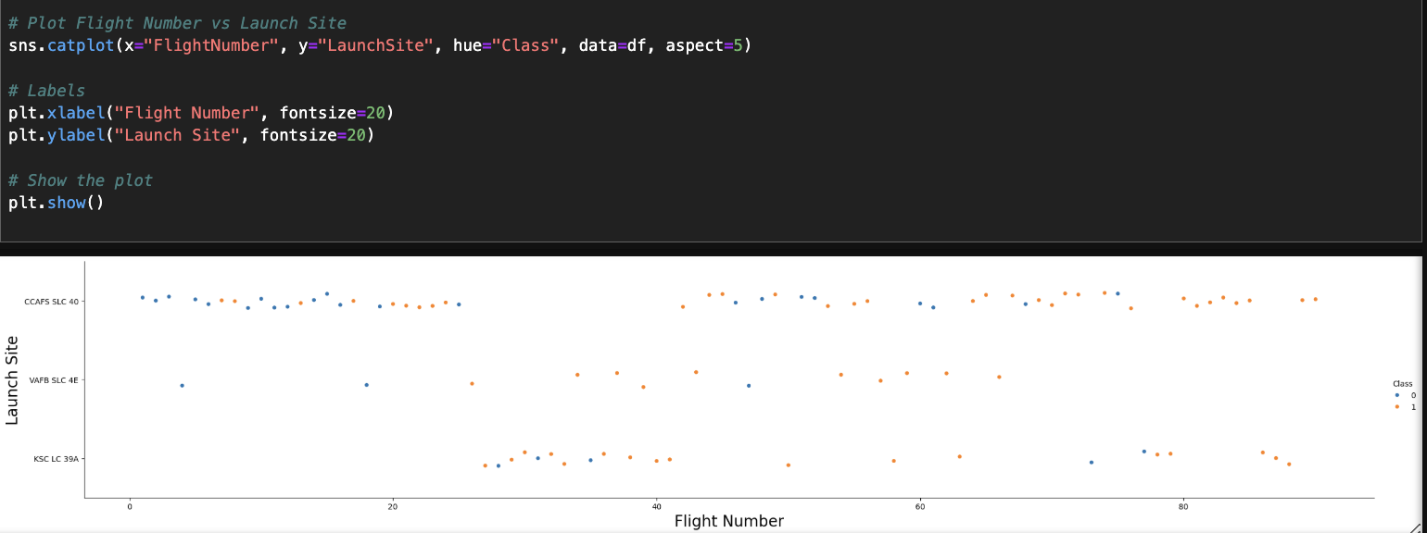
Flight Number vs. Launch Site
https://github.com/cnabolouri/cnabolouri.github.io.git

Slide 27
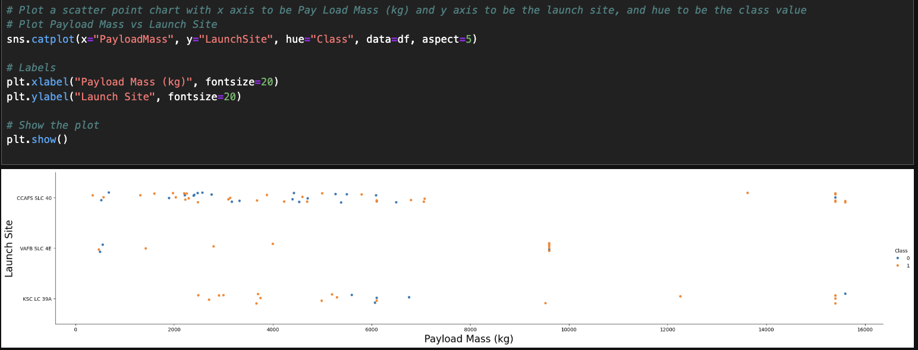
Payload vs. Launch Site
https://github.com/cnabolouri/cnabolouri.github.io.git

Slide 28
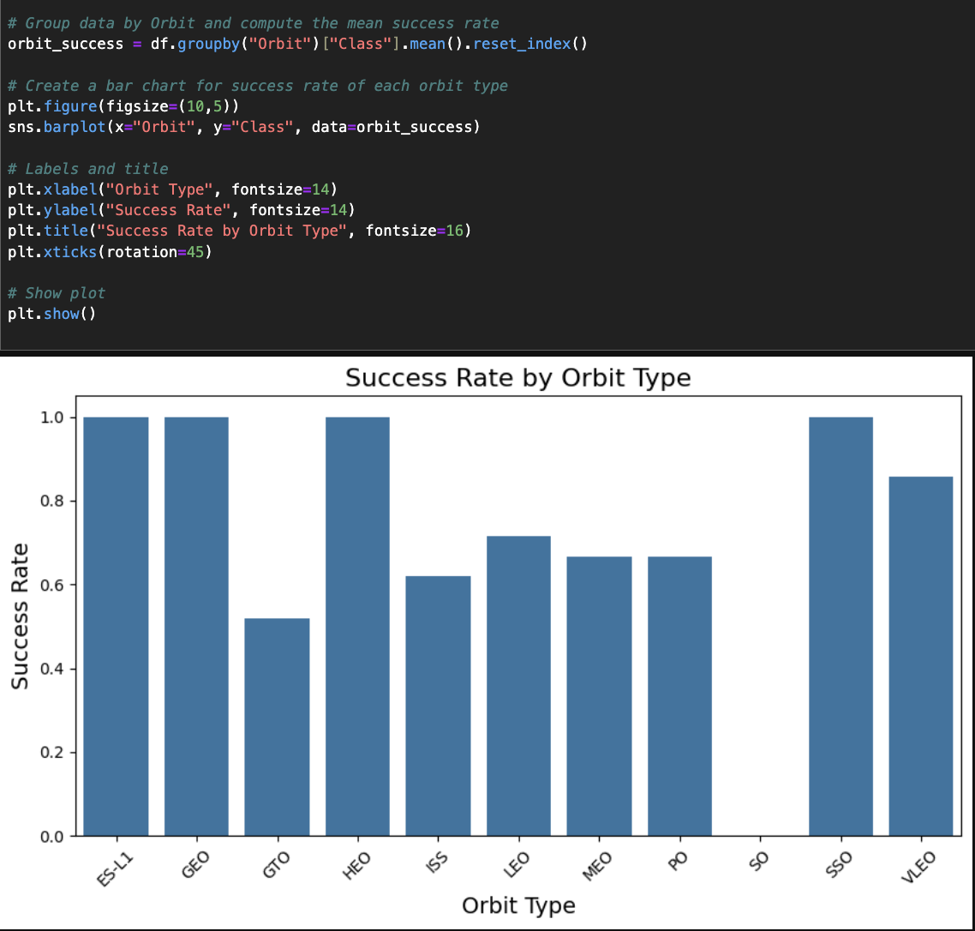
Success Rate vs. Orbit Type
https://github.com/cnabolouri/cnabolouri.github.io.git

Slide 29
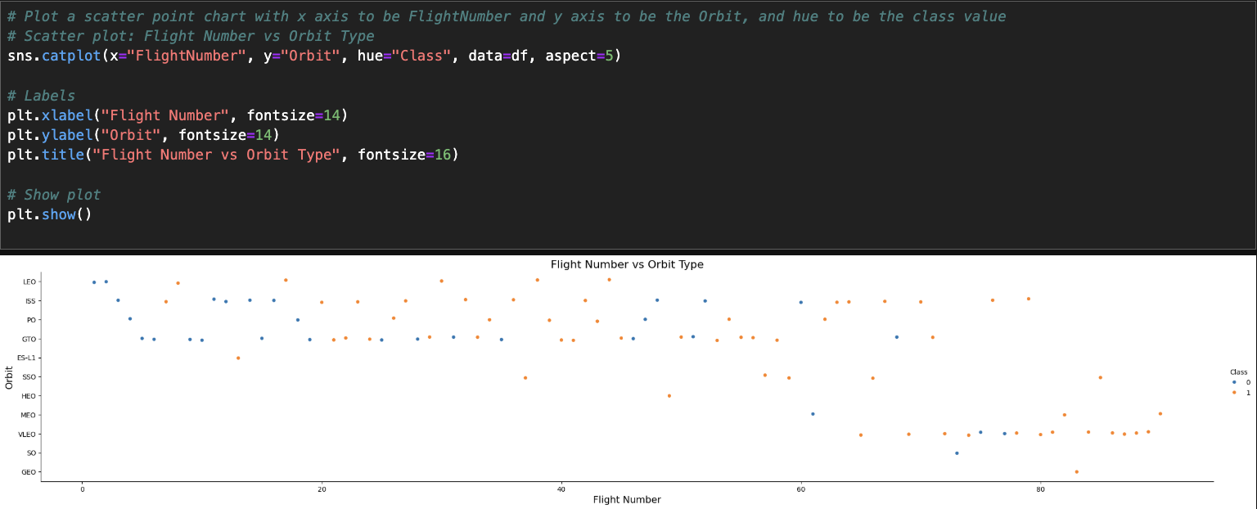
Flight Number vs. Orbit Type
https://github.com/cnabolouri/cnabolouri.github.io.git

Slide 30
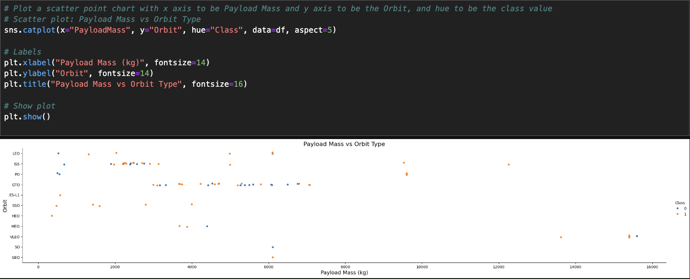
Payload vs. Orbit Type
https://github.com/cnabolouri/cnabolouri.github.io.git

Slide 31
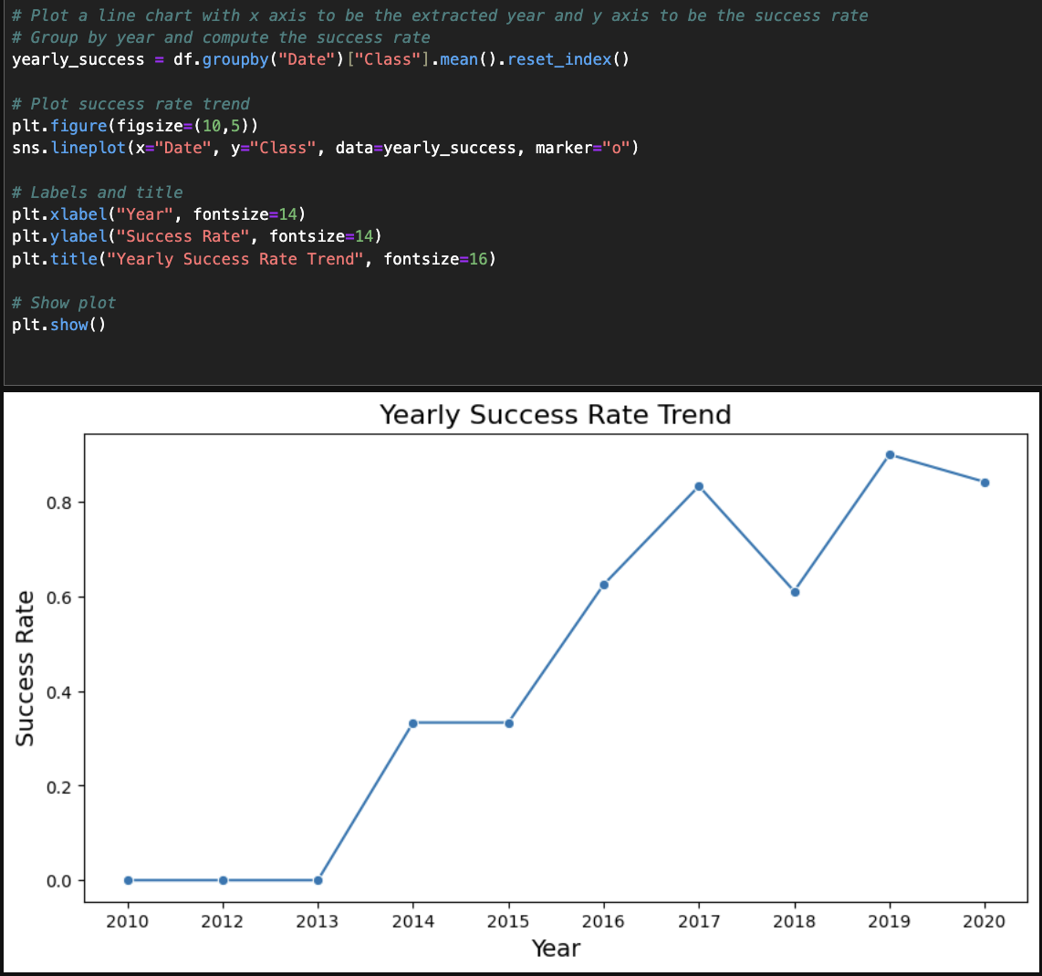
Launch Success Yearly Trend
https://github.com/cnabolouri/cnabolouri.github.io.git

Slide 32
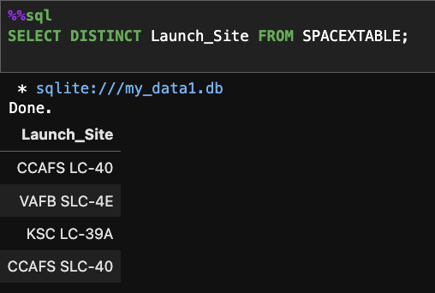
All Launch Site Names
https://github.com/cnabolouri/cnabolouri.github.io.git

Slide 33
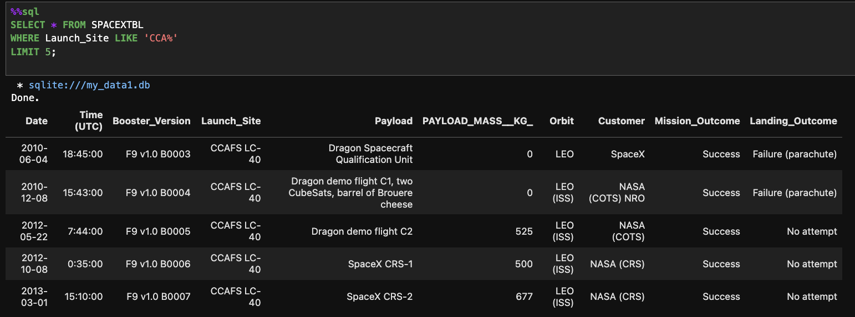
Launch Site Names Begin with 'CCA'
https://github.com/cnabolouri/cnabolouri.github.io.git

Slide 34
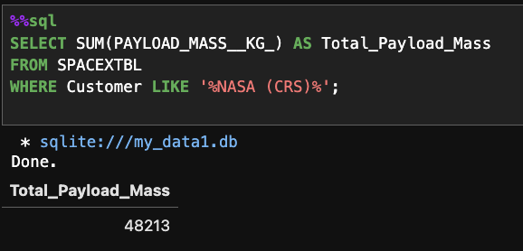
Total Payload Mass
https://github.com/cnabolouri/cnabolouri.github.io.git

Slide 35
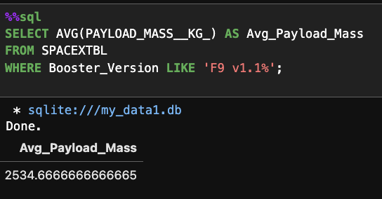
Average Payload Mass by F9 v1.1
https://github.com/cnabolouri/cnabolouri.github.io.git

Slide 36
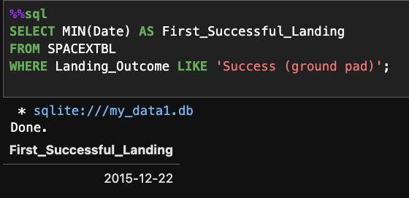
First Successful Ground Landing Date
https://github.com/cnabolouri/cnabolouri.github.io.git

Slide 37
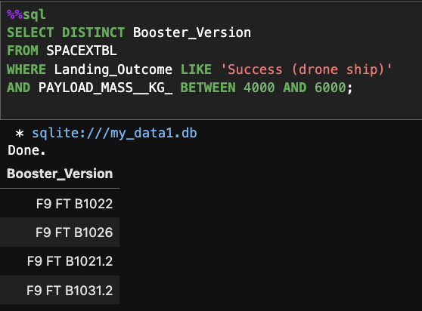
Successful Drone Ship Landing with Payload between 4000 and 6000
https://github.com/cnabolouri/cnabolouri.github.io.git

Slide 38
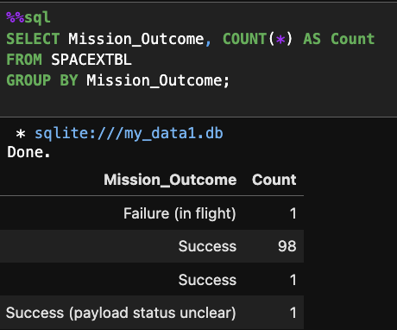
Total Number of Successful and Failure Mission Outcomes
https://github.com/cnabolouri/cnabolouri.github.io.git

Slide 39
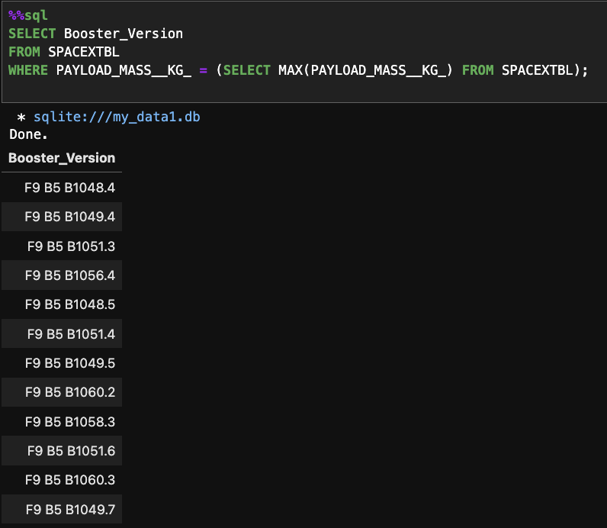
Boosters Carried Maximum Payload
https://github.com/cnabolouri/cnabolouri.github.io.git

Slide 40
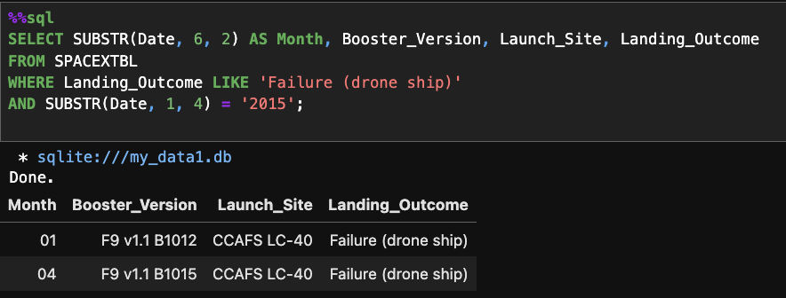
2015 Launch Records
https://github.com/cnabolouri/cnabolouri.github.io.git

Slide 41
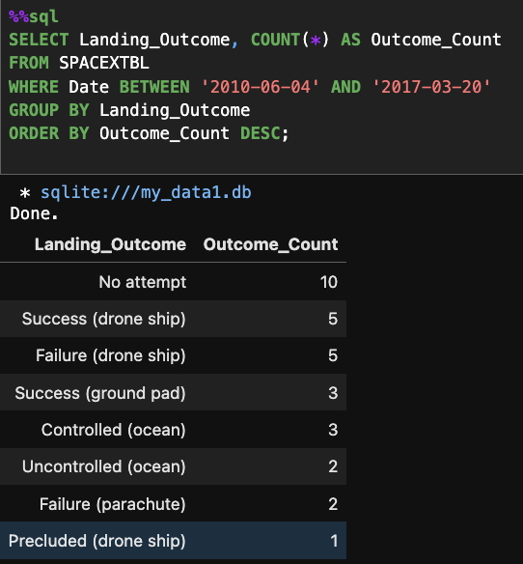
Rank Landing Outcomes Between 2010-06-04 and 2017-03-20
https://github.com/cnabolouri/cnabolouri.github.io.git

Slide 42

Section 3
https://github.com/cnabolouri/cnabolouri.github.io.git

Slide 43
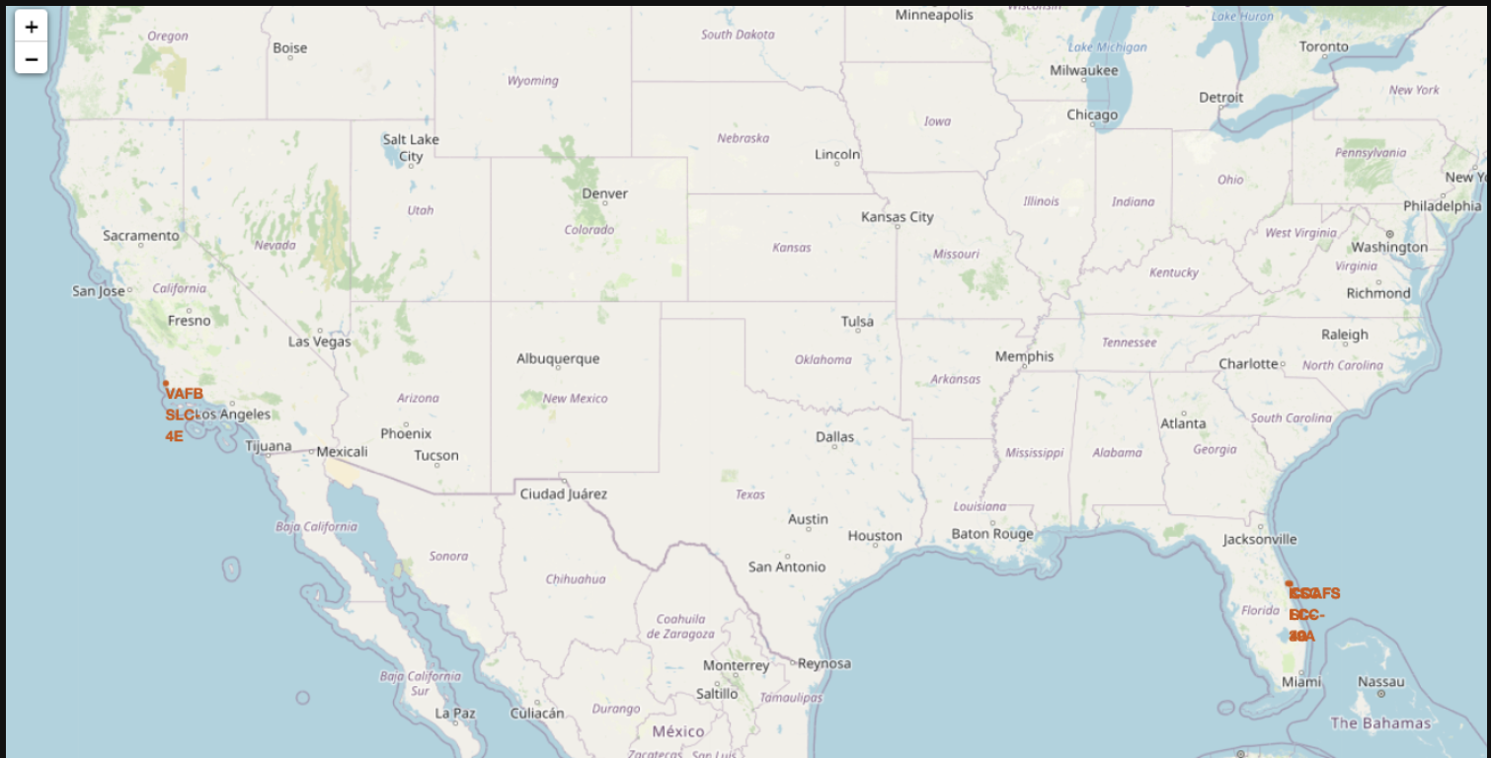
Visualizing SpaceX Launch Sites on an Interactive Map
https://github.com/cnabolouri/cnabolouri.github.io.git

Slide 44
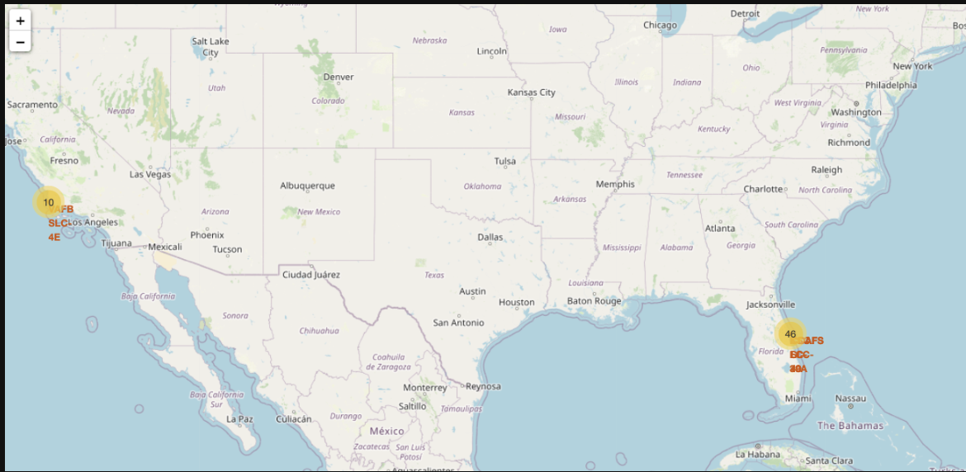
Mapping SpaceX Launch Outcomes with Color-Coded Markers
https://github.com/cnabolouri/cnabolouri.github.io.git

Slide 45
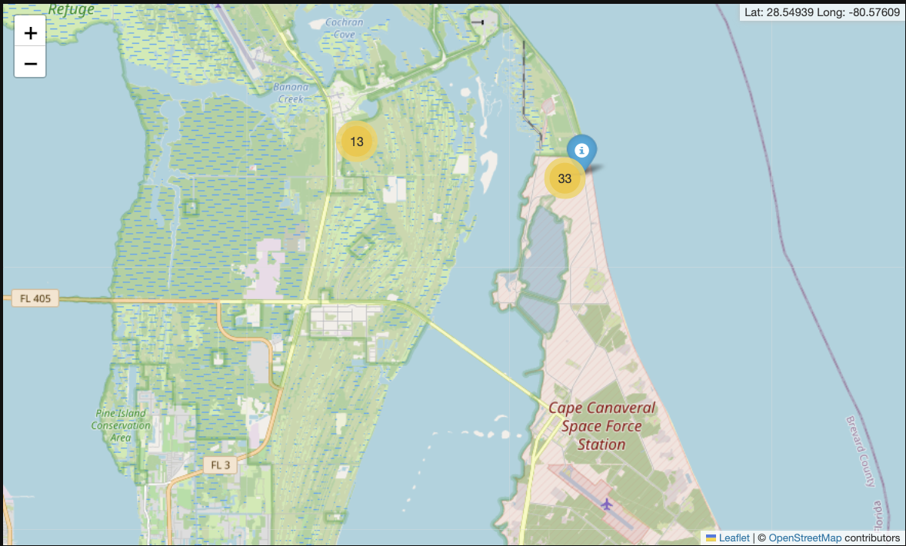
Analyzing Launch Site Proximities: Distance to Railways, Highways, and Coastlines
https://github.com/cnabolouri/cnabolouri.github.io.git

Slide 46

Section 4
https://github.com/cnabolouri/cnabolouri.github.io.git

Slide 47
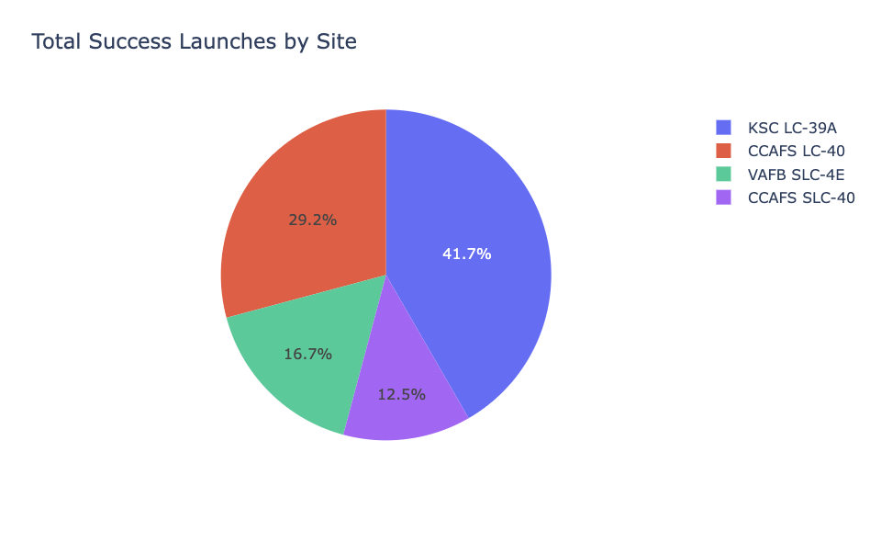
Launch Success Distribution: Pie Chart Overview
Insights and Key Takeaways:
The KSC LC-39A site appears to be the most preferred and successful launch site.
CCAFS LC-40 and VAFB SLC-4E also show significant contributions.
CCAFS SLC-40 has the lowest success share, possibly due to fewer launches or technical challenges at the site.
https://github.com/cnabolouri/cnabolouri.github.io.git

Slide 48
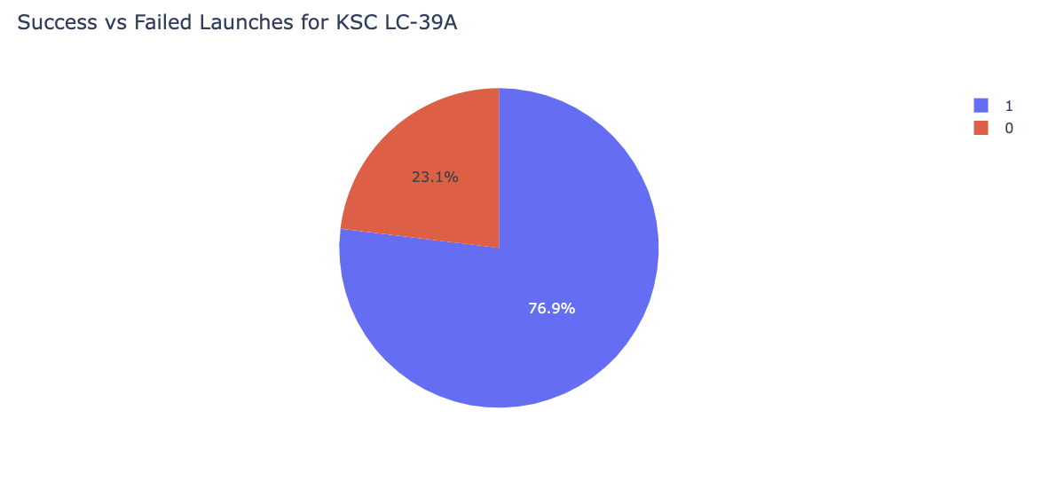
Launch Success Ratio by Site – Highest Performing Site: Pie Chart Overview
Key Findings
Identify the site with the highest success ratio.
If one site significantly outperforms others, it may indicate better launch conditions, improved booster versions, or superior technology.
https://github.com/cnabolouri/cnabolouri.github.io.git

Slide 49
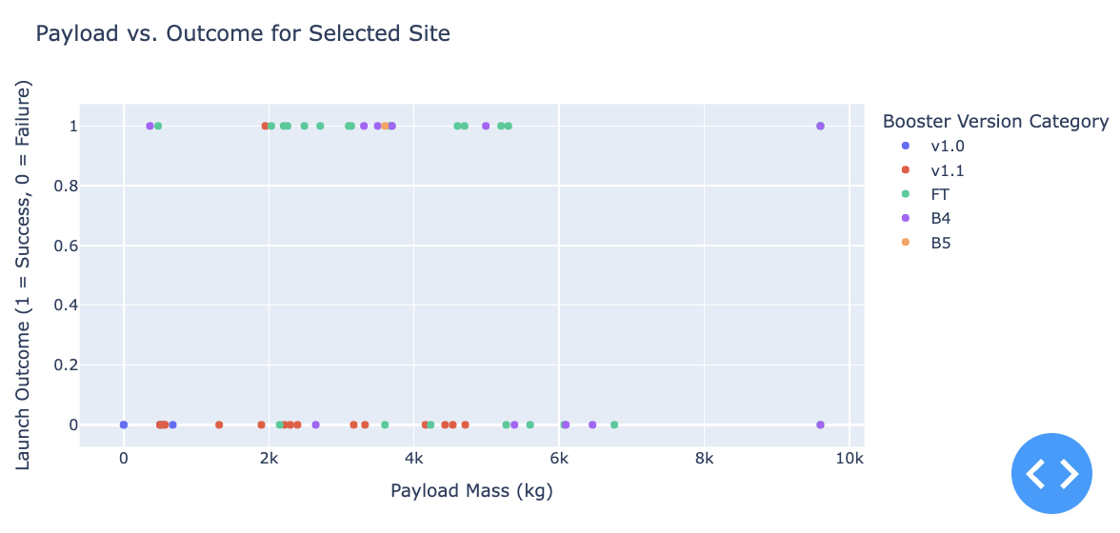
Payload vs. Outcome for All Sites: Scatter Plot Overview
Key Findings:
SpaceX’s later booster versions (FT, B4, B5) tend to have higher success rates.
Launches with lower payloads tend to have more failures, possibly due to early-stage technology.
Heavy payload launches (closer to 10,000 kg) show more successful landings, suggesting advancements in booster design.
https://github.com/cnabolouri/cnabolouri.github.io.git

Slide 50

Section 5
https://github.com/cnabolouri/cnabolouri.github.io.git

Slide 51
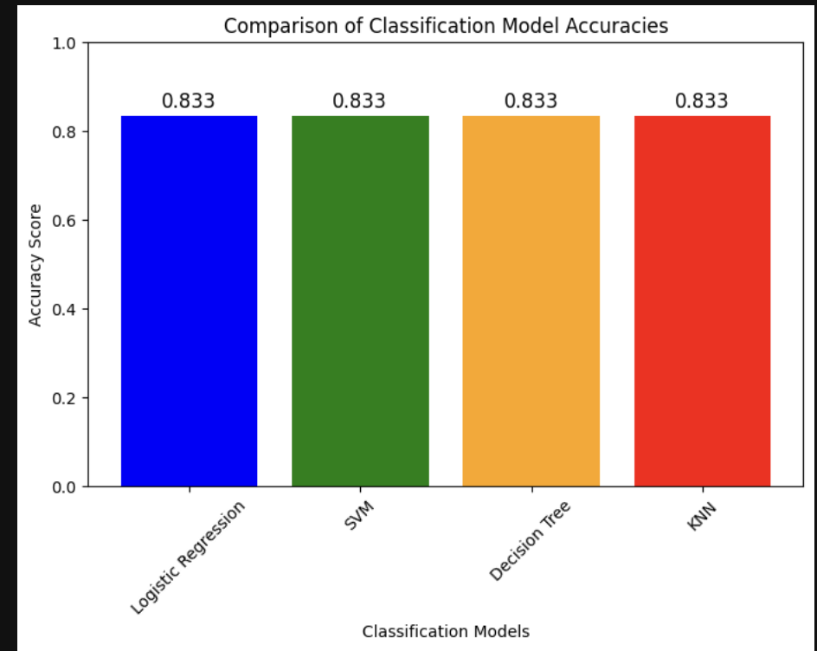
Classification Accuracy
https://github.com/cnabolouri/cnabolouri.github.io.git

Slide 52
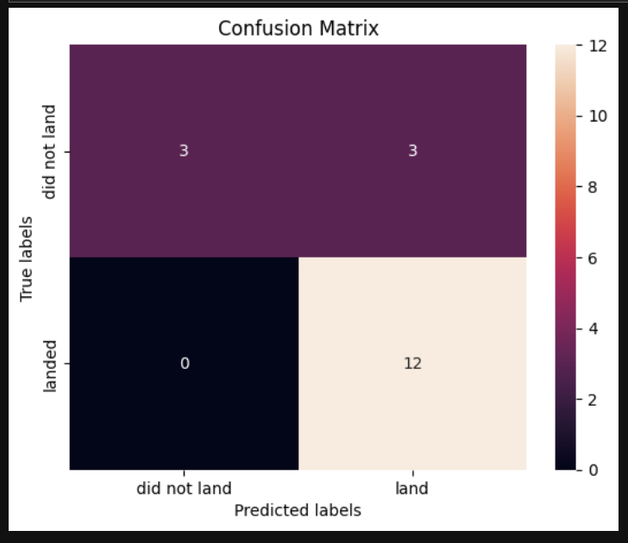
Confusion Matrix
Key Findings:
- High Correct Classification Rate: The model correctly predicts all 12 successful landings (100% recall) and identifies 3 out of 6 failed landings.
- Zero False Negatives: It ensures successful landings are not misclassified as failures, which is crucial for decision-making.
- Trade-off between False Positives and False Negatives: The model has 3 false positives, but this is acceptable. Misclassifying a failed landing as successful is more serious than having false positives.
- Effective Handling of Non-Linearity: Decision trees capture complex patterns influenced by factors like weather and payload, unlike linear models.
https://github.com/cnabolouri/cnabolouri.github.io.git

Slide 53
Conclusions
Data-Driven Insights: Analyzed SpaceX launch data to identify key factors influencing booster landing success.
Geospatial Analysis: Mapped launch sites, examined proximity to coastlines, highways, and railways, and evaluated site efficiency.
Interactive Dashboard: Developed a Plotly Dash tool for visualizing launch success rates and payload relationships dynamically.
Machine Learning Predictions:
Trained multiple models to predict booster landing success.
Decision Tree emerged as the best model, minimizing false negatives and providing the most reliable predictions.
Key Takeaways:
Machine learning can optimize mission success rates and reduce costs.
Geospatial analysis helps in strategic site selection and launch planning.
Predictive models can assist in future mission planning and risk assessment.
https://github.com/cnabolouri/cnabolouri.github.io.git

Slide 54

https://github.com/cnabolouri/cnabolouri.github.io.git

